Slide 1
HEC-RAS
http://www.hec.usace.army.mil/software/hec-ras/hecras-hecras.html
US Army Corps of Engineers
Hydrologic Engineering Center
River Analysis System
Legend
WS 10 yr
WS 50 yr
WS 100 yr
Ground
Bank Station

Slide 2
Software for Steady-State Water Surface Profiles
HEC-RAS analyzes networks of natural and man-made channels and computes water surface profiles based on steady one-dimensional flow hydraulics.
includes
composite channels
supercritical-to-subcritical flows
multi-waterway bridges
culvert options
Stable channel design

Slide 3
Hydraulic Analysis Components
Steady Flow Water Surface Profiles
flood plain management
flood insurance studies
effects of channel modifications
Unsteady Flow Simulation
model __________
levee failures
Sediment Transport/Movable Boundary
long term trends of scour and deposition
maximum scour during large flood events
design channels to maintain navigation depths
storage

Slide 4
Steady Flow Water Surface Profiles
Systems of channels
network
dendritic
single river reach
Subcritical, Supercritical, and Mixed
Channel Controls/Obstructions
bridge piers
culverts
weirs
branching

Slide 5
Computational Procedure
One-dimensional energy equation (_______ ___)
energy losses
friction - Manning Equation
contraction/expansion - loss coefficient
Momentum equation
hydraulic jumps
hydraulics of bridges
stream junctions
standard step

Slide 6
Computational Procedure (1)
Assume a water surface elevation at the upstream cross section (or downstream cross section if a supercritical profile is being calculated)
Based on the assumed water surface elevation, determine the corresponding total conveyance and velocity head.
Notes:
1. Assume a water surface elevation at the upstream cross section (or
downstream cross section if a supercritical profile is being calculated).
2. Based on the assumed water surface elevation, determine the
corresponding total conveyance and velocity head.
3. With values from step 2, compute S
f and solve Equation 2-2 for he.
4. With values from steps 2 and 3, solve Equation 2-1 for WS2.
5. Compare the computed value of WS2 with the value assumed in step 1;
repeat steps 1 through 5 until the values agree to within .01 feet (.003
m), or the user-defined tolerance.

Slide 7
Computational Procedure (2)
Compute S_{f} and solve for losses
Solve the energy equation for the water surface
Compare the computed value of depth with the assumed value and ______ until the values agree within 0.01 feet.
= h_{e}
iterate

Slide 8
Data Requirements
Channel description
length of reach
channel roughness
channel cross-section geometry
Boundary conditions
Structure geometry
bridges
culverts
weirs

Slide 9
River Reach
0.2
10
Tributary
F
a
Upper Reach
0.1
l
l
C
r
.
R
i
t
e
River Stations
v
9.9
t
e
r
u
B
Numeric labels increase upstream
9.8
0.0
Sutter
F
a
l
9.7
l
R
i
v
Lower Reach
e
r
9.6
9.5

Slide 10
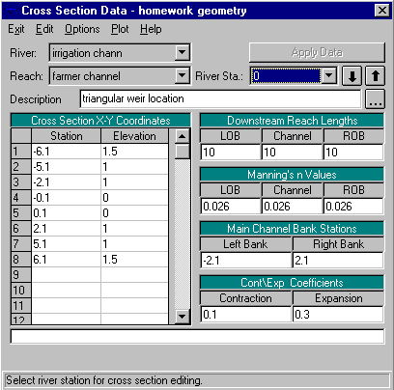
Cross Section Data
x-y coordinates of channel bottom
distance to downstream cross-section
Manning’s n

Slide 11
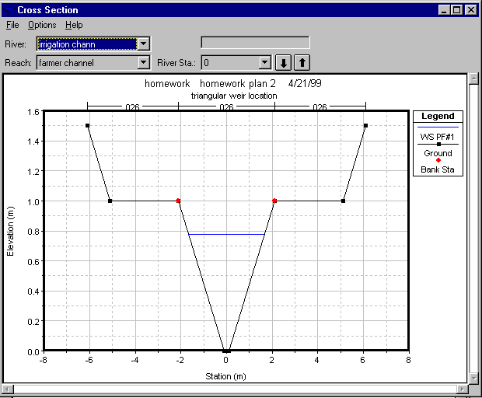
Channel Cross Section
Manning n for overbank areas usually higher than for main channel
Composite channel calculations...

Slide 12
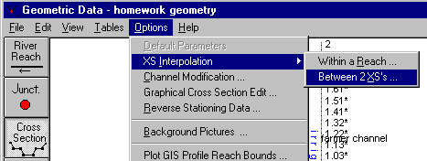
Channel Section Interpolation
Water surfaces are calculated at each river station
If water depth changes too much between river stations then the calculations are imprecise
Interpolate between rivers stations of known geometry

Slide 13
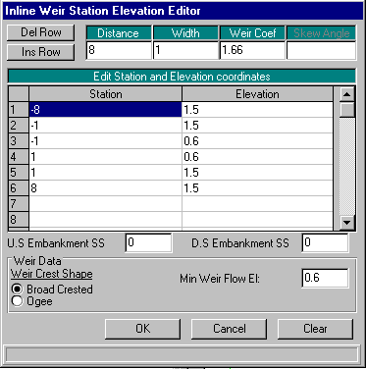
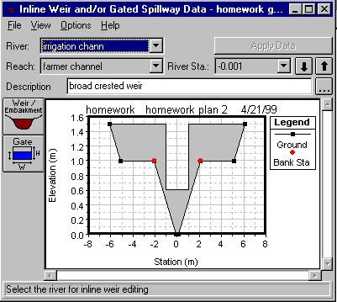
Inline Weir Station Elevation Editor
Weir Editor
Resulting cross section

Slide 14
Boundary Conditions
Ways to specify Boundary Conditions
Known Water Surface Elevations
Critical Depth _______________
Normal Depth _______________
Rating Curve _______________
Boundary Condition Requirements
Supercritical Flow ______________
Subcritical Flow ______________
Mixed Flow ______________
Mild to Steep Transition
Uniform flow
Control structure
Upstream depth
Downstream depth
Upstream and Downstream

Slide 15
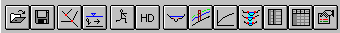
Program Structure
Input
Output
Cross Sections
Channel geometry
Profiles
Flows and boundary conditions for each profile
Computed Rating Curves
3-D Cross Sections
Other Analysis
Tabular Data
Scour at bridges
Errors

Slide 16
Change from Mild to Steep Slope
From this plot how can you know if flow is super or sub critical?
M₂
S₂

Slide 17
Mild slope behind Obstruction
M₁

Slide 18
Additional Capabilities
Stable Channel Design
Sediment transport problem
Perform Channel Modifications
Cut and fill calculations

Slide 19
HEC-RAS Summary
HEC-RAS solves the energy and momentum equations to calculate water surface profiles
Modeling natural rivers is made difficult by the need to obtain and enter the geometric data

Slide 20
Wee Stinky Creek Problems
What is wrong with Wee Stinky Creek?
Bank erosion
Is channel bed eroding also?
Why is erosion a concern?
Local - land/soil loss
Downstream – sediment deposition
What could be causing the erosion?
Steep slope
Impermeable surfaces with high runoff
Lack of bank vegetation
Lawn mowers

Slide 21
Wee Stinky Creek Solutions
Decrease stream slope
Meander
Raise downstream sill
Increase bottom width
Decrease side slope
Plant vegetation with deep roots next to stream
Keep the lawn equipment away from the stream

Slide 22
Wee Stinky Design
How will you provide evidence that your design will solve the problem?

Slide 23
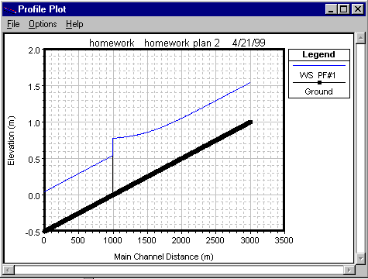
Water Surface Profiles

Slide 24
Broad-crested Weir
3-D Cross Sections

Slide 25
Boundary Condition Editor
Known Water Surface
Critical Depth
Normal Depth
Rating Curve

